Slide 1
MARKETING ANALYTICS I
SESSION 1:
REQUEIM FOR A BRAND
UT Austin MSBA Program
Professor Sonnier
Fall 2022

Slide 2











SUCCESSFUL COMPANIES
What Companies Come to Mind?

Slide 3
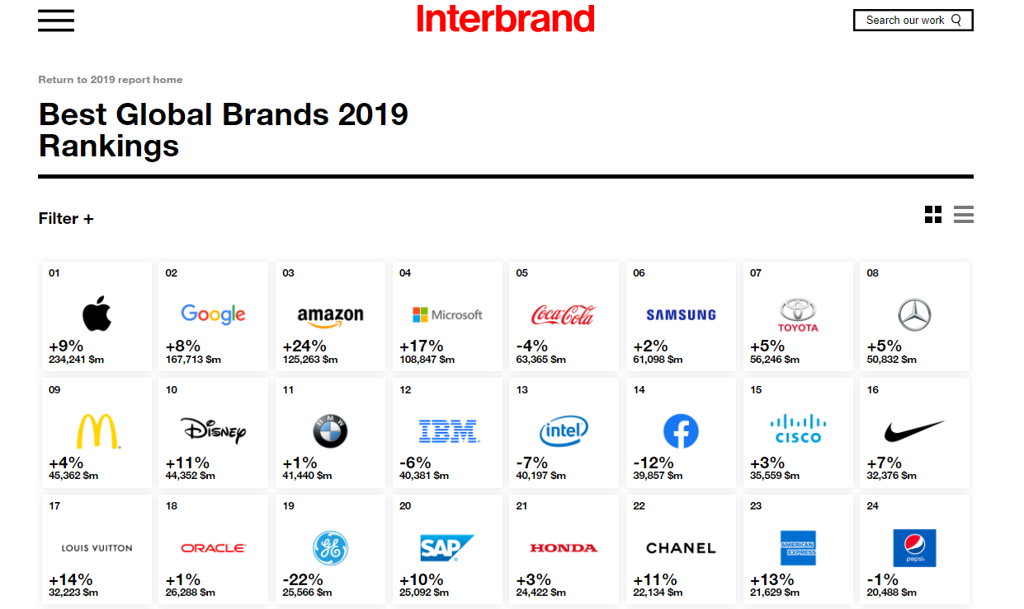
SUCCESSFUL COMPANIES
Global Brand Rankings (2019)

Slide 4
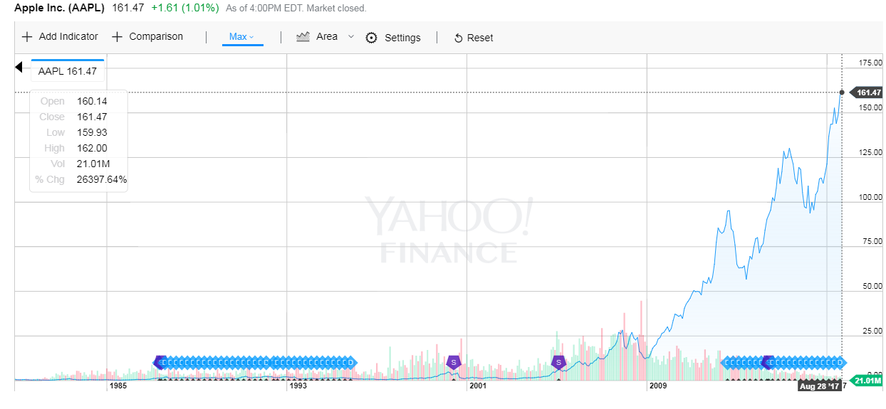
SUCCESSFUL COMPANIES
Apple Stock Price Over Time

Slide 5
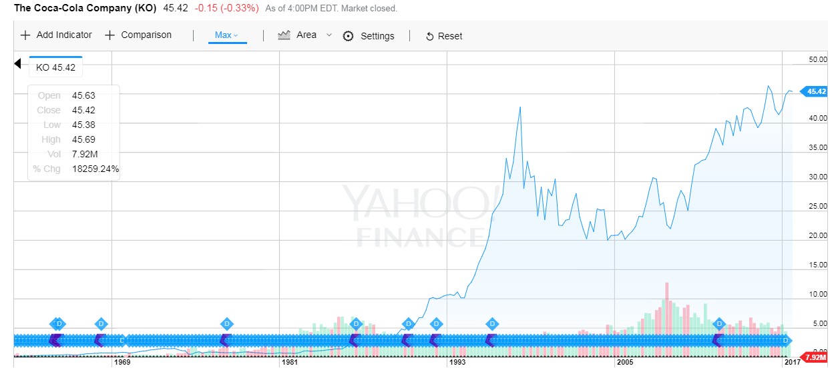
SUCCESSFUL COMPANIES
Coca-Cola Stock Price Over Time

Slide 6
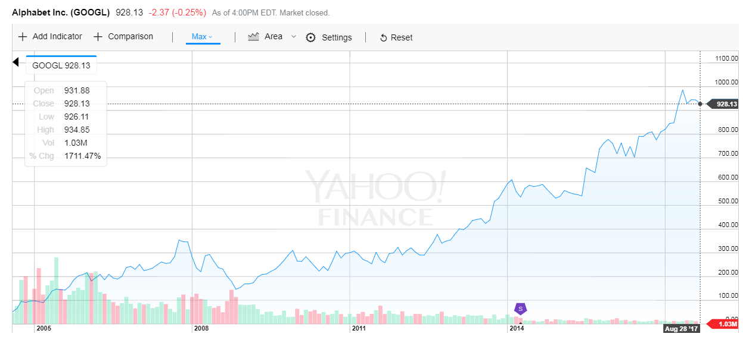
SUCCESSFUL COMPANIES
Alphabet (Google) Stock Price Over Time

Slide 7
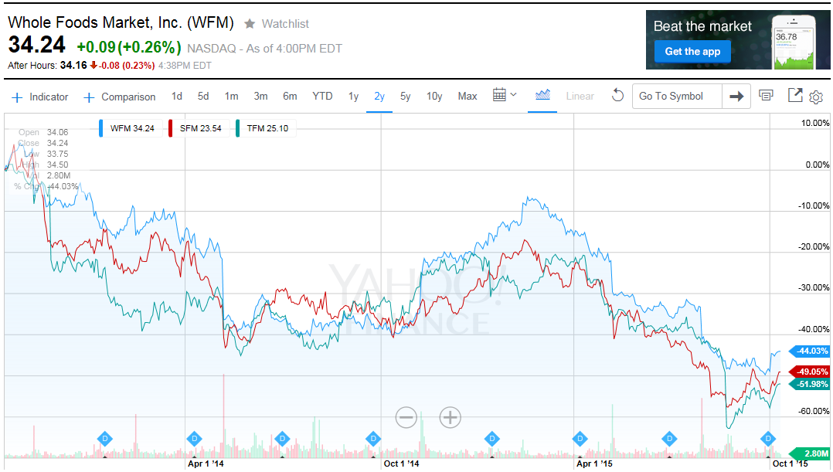
WFM vs. TFM (Fresh Market) and SFM (Sprouts Farmer’s Market)
WHOLE FOODS
Tough Times for Organic Grocers

Slide 8
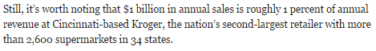
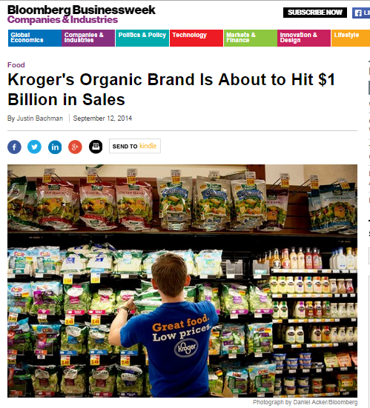
WHOLE FOODS
Who Are The Competitors?
http://www.businessweek.com/articles/2014-09-12/krogers-organic-food-sales-are-about-to-hit-1-billion

Slide 9
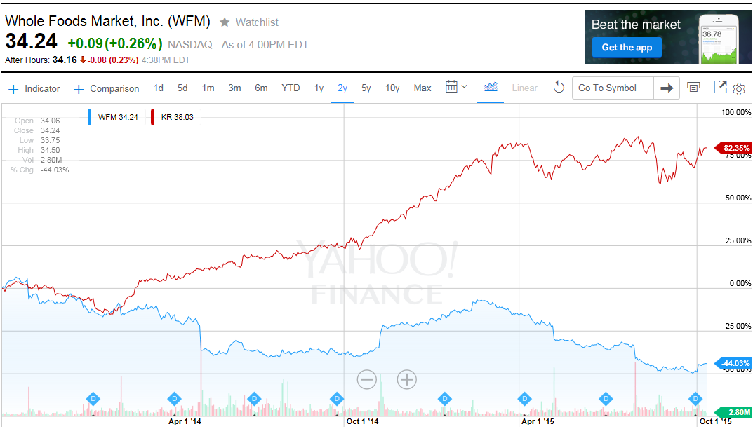
WFM vs. KR (Kroger)
WHOLE FOODS
Who Are The Competitors?

Slide 10
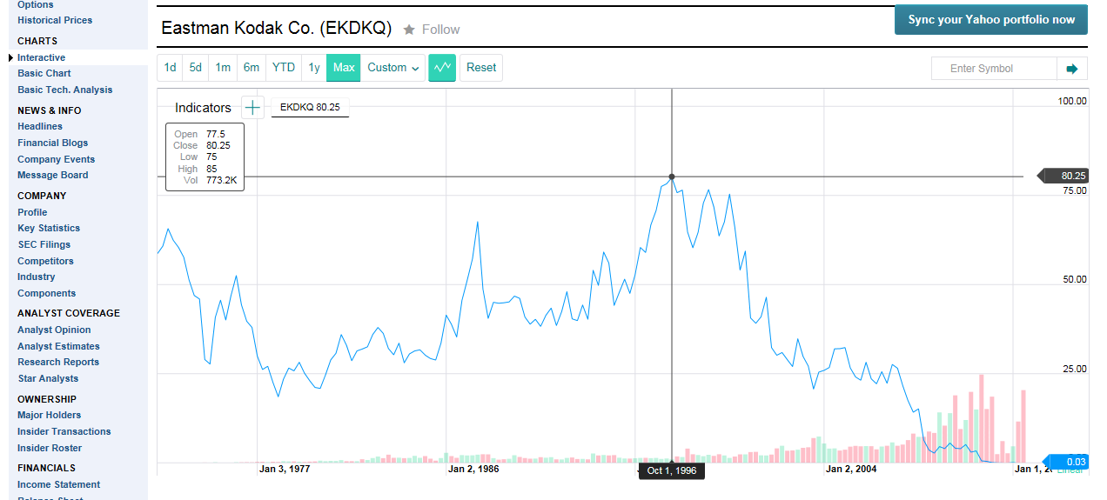
A STORY OF VALUE DESTRUCTION
Kodak Stock Price Over Time
Kodak’s market cap peaked at nearly $30 billion in 1997
A little over a decade later it was gone
Ouch!

Slide 11


A STORY OF VALUE DESTRUCTION
What Killed Kodak?

Slide 12
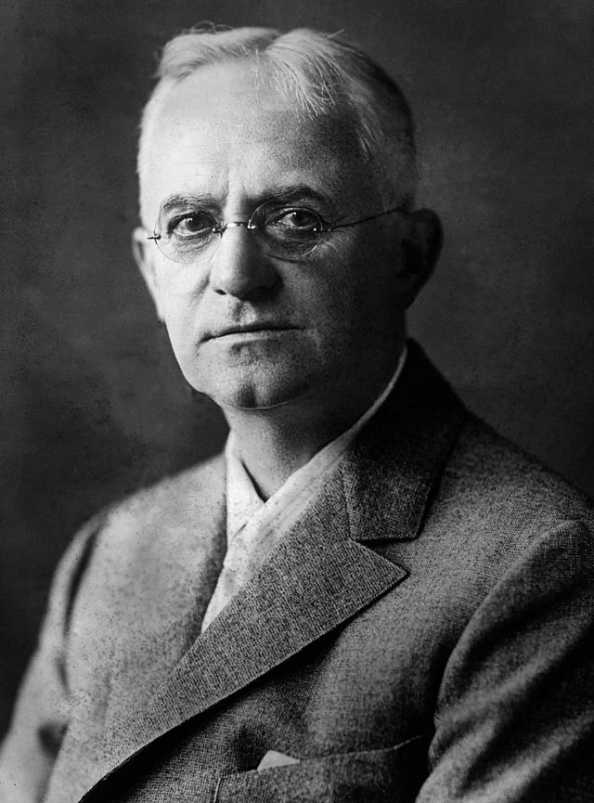
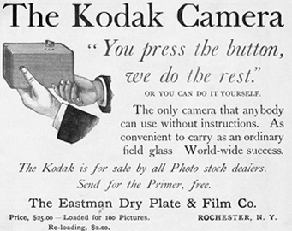
KODAK
An Iconic American Brand is Born

Slide 13
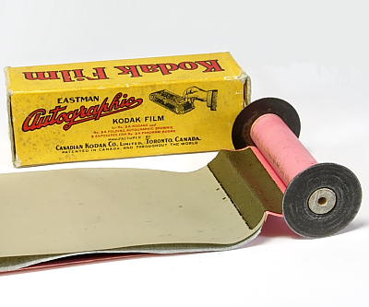
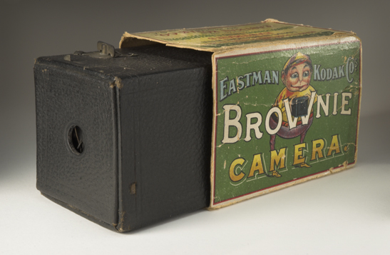
KODAK
Early Market Strategies
Sell this for cheap
Make money selling this!

Slide 14
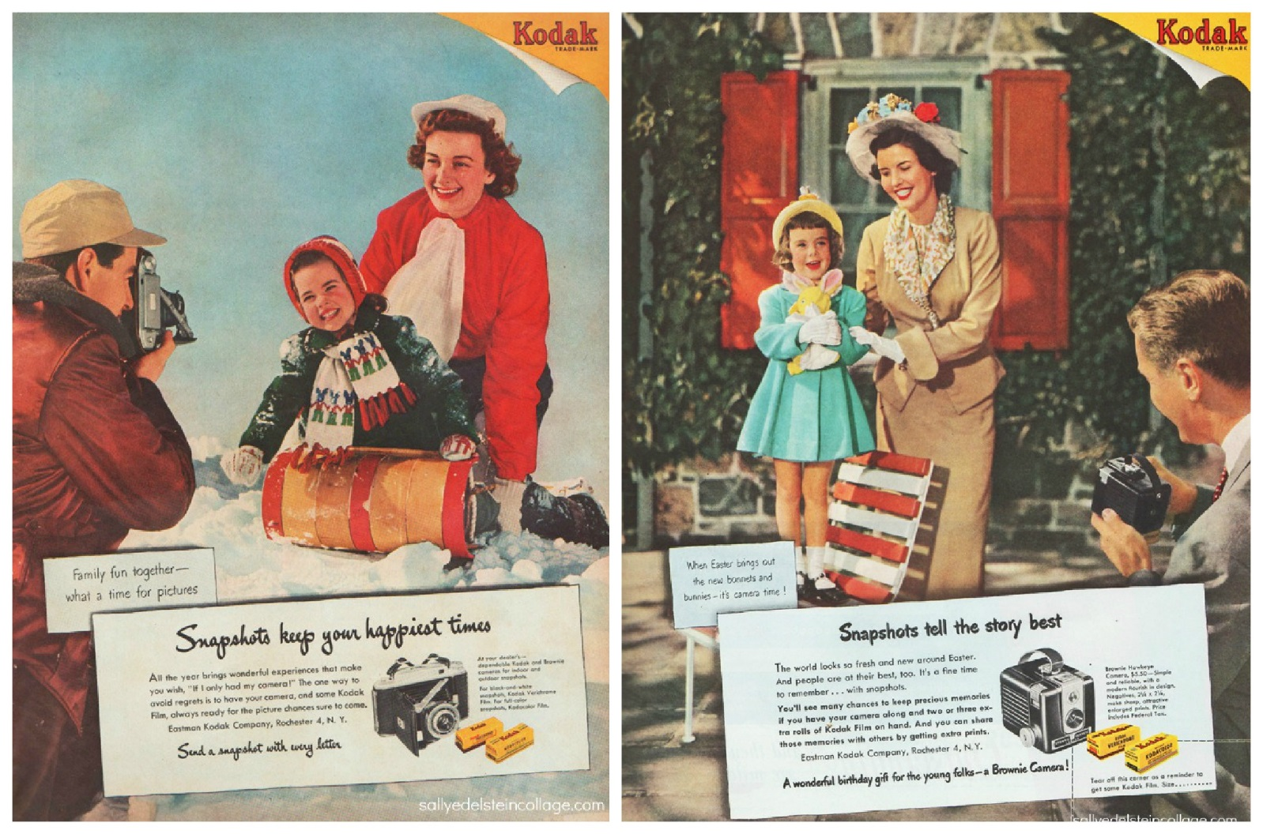
KODAK
Deploying Advertising to Create Awareness and Stimulate Demand

Slide 15

KODAK
A Strong Commitment to Research and Development
Kodak begins R&D into color film in the 1920’s
By 1963 the company had spent over $120MM on R&D for color film
The investment costs and manufacturing complexity created significant barriers to entry in the film business
In mid 70’s Kodak had 90% of the U.S. film market and 85% of the camera market
Sales topped $10 billion in 1981
Profits largely came from film and related chemical and paper sales

Slide 16
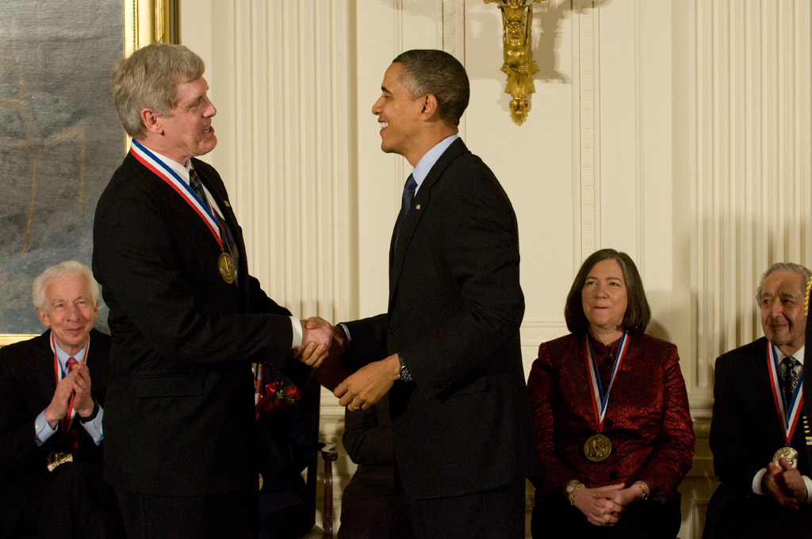
KODAK
A Strong Commitment to Research and Development

Slide 17
KODAK
What to Do About Digital When You Make Tons of Money Selling Film?
Digital Adoption
Scenario 3:
Takeoff in 2000
Scenario 2:
Takeoff in 1990
Scenario 1:
Takeoff in 1980
1980
1990
2000
A model to forecast adoption timing would be helpful…

Slide 18
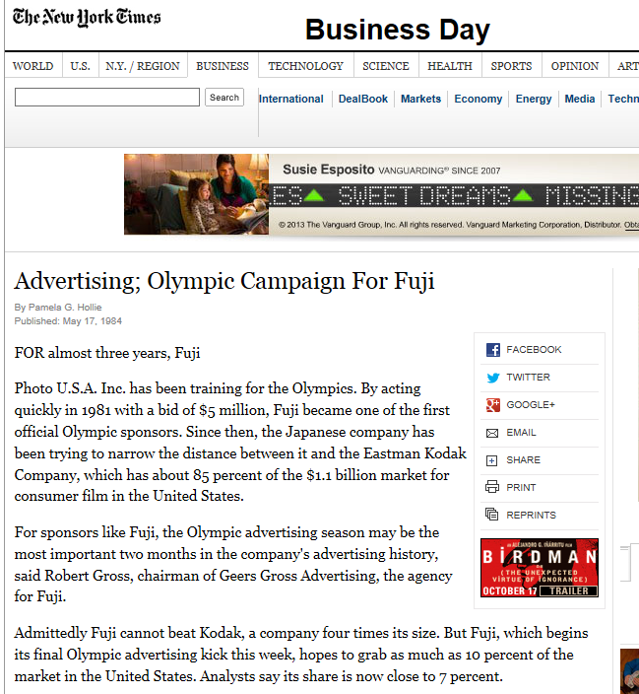

KODAK
About that Film Market…
Retail value of film market is $1.1B in 1984

Slide 19
KODAK
The Situation in Rochester a Decade Later
In 1994 670MM rolls of film were sold
Kodak had a 70% share of this market (469MM rolls of film)
Kodak film retailed at $3.49
At retail the market is worth $1.637B
What is Kodak’s piece of this market?

Slide 20
KODAK
Marketing Economics: Margin Analysis
Price
The dollar margin is the difference in price and selling costs
Margin
The % margin is the margin computed as a percentage of the selling price*
Costs
*You should assume % margin refers to margin as a percentage of selling price unless other wise noted.

Slide 21
KODAK
Marketing Economics: Actual Channel Margins circa 1993
Retail
Price
Dealer’s* Margin
Gold Plus: $3.49 at retail
Dealer Profit Margin: 20%
Kodak Profit Margin: 70%
What are the $ margins and costs for the dealers and for Kodak?
Retailer Cost=
Manufacturer Price
Kodak’s Margin
Manufacturer Cost
*NOTE: We use the term dealer and retailer interchangeably.

Slide 22
KODAK
Marketing Economics: Kodak Margin Analysis circa 1993
For the retailer
Gold Plus: $3.49 at retail
Retailer Profit Margin: 20%
Dealer earns $0.70 on each roll of film
Kodak wholesales film at $2.79 per roll

Slide 23
KODAK
Marketing Economics: Kodak Margin Analysis
For Kodak
Wholesale Price is $2.79
Kodak margin is %70
Kodak earns $1.95 on each roll of film
Kodak manufacturing costs are $0.84 per roll

Slide 24
KODAK
Marketing Economics: Margin Analysis
These are unit prices, costs and margins
We can consider aggregate revenues, costs, and contribution

Slide 25
KODAK
Summing Up the Top Line and Bottom Line
Some observations
Kodak’s contribution is nearly $1 billion a year in 1993
At current prices each point of 70 points of market share is worth about $13MM in contribution
Advertising expenditures are only about 5% of Kodak’s contribution
*At $3.49 per roll retail price
**Kodak share of retail market is (1-20%)=80%
***Kodak %margin is 70%

Slide 26
KODAK
Variable Costs and Fixed Advertising Costs
Advertising costs are fixed at $50MM
Variable costs are given by Sales x $0.84
At what point does total revenue exceed total costs?

Slide 27
KODAK
Breakeven Sales Volume
Revenues are Sales x $2.79
Breakeven sales volume is the point at which total revenues just equal total costs
Sales x Prices = Sales x Unit Costs + Fixed Costs

Slide 28
KODAK
Breakeven Sales Volume
Breakeven Volume:
Sales x Prices = Sales x Unit Costs + Fixed Costs
Sales x [Prices-Unit Costs] = Fixed Costs
Sales = Fixed Costs / [Prices-Unit Costs]

Slide 29
KODAK
Breakeven Sales Volume
Breakeven Volume on $50MM Adv. Costs:
Sales = $50 MM / [$1.95]
Sales = 25.64 MM
At current margin, once film sales exceed 25.64 MM roles Adv. costs are covered

Slide 30
KODAK
Breakeven Sales Volume
Breakeven volume on the $50MM ad spend is a guide to how much the firm would need to sell given their price and cost
It does not speak to feasibility
although in this case 26.6MM rolls of film is certainly feasible
It does not speak to optimality of price and advertising policies
This would requires some knowledge of the relationship between sales and ad spend
Unit Margins, Profits, and Breakeven Volumes are mathematical identities.
For example, if you know unit price and unit costs you know unit margin with certainty
The relationship between sales and price, advertising and other marketing mix variables is an empirical relationship
Other possibly unknown factors determine sales besides the marketing mix. Thus, a probabilistic rule or weight characterizes the relationship between sales and marketing.

Slide 31
CUSTOMER VALUE: WHY DO WE BUY?
Customers Earn Margins, Too!
Consumer
Reservation Value
Value to the Customer
Retail
Price to Consumer
The reservation value is the maximum the consumer would be willing to pay to obtain the product
Retailer Margin
Wholesale
Price to Retailer
Manufacturer Margin
Unit
Manufacturing
Costs

Slide 32
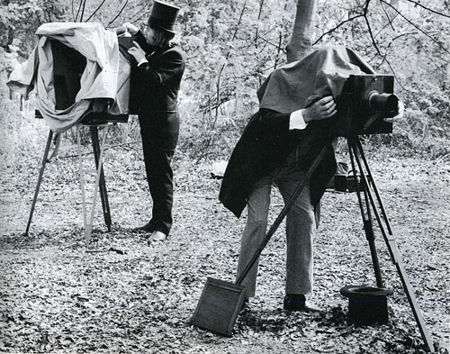
KODAK
How Does Kodak Create Value for Customers?
Photography in the late 1800’s
Value in Use

Slide 33
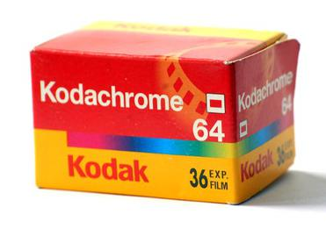
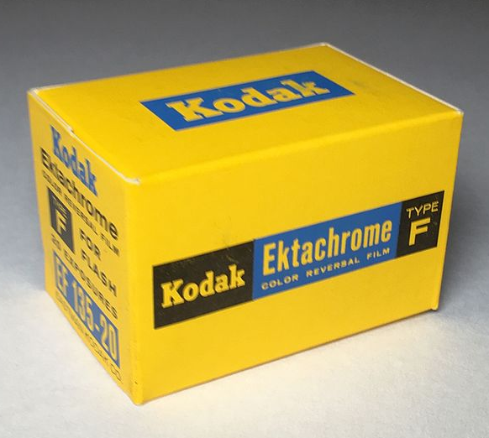
KODAK
How Does Kodak Create Value for Customers?
Photography in the mid 1900’s
Value for Functional Attributes
Kodachrome is a brand name for a non-substantive, color reversal film introduced by Eastman Kodak in 1935.^{[2]} It was one of the first successful color materials and was used for both cinematography and still photography. Because of its complex processing requirements, the film was sold process-paid in the United States until 1954 when a legal ruling prohibited this. Elsewhere, this arrangement continued. For many years it was used for professional color photography, especially for images intended for publication in print media.*
*https://en.wikipedia.org/wiki/Kodachrome
Although Kodachrome is often considered a superior film due to its archival qualities and color palette, advances in dye and coupler technology blurred the boundaries between the differing processes…*
*https://en.wikipedia.org/wiki/Ektachrome

Slide 34
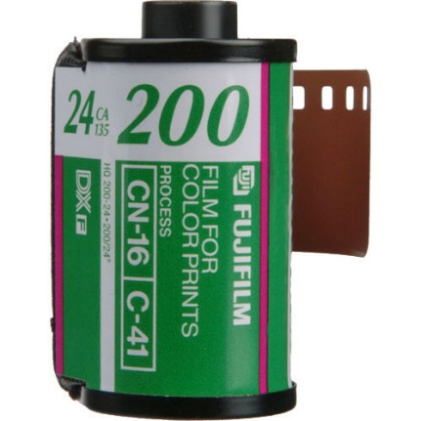

KODAK
How Does Kodak Create Value for Customers?
Photography in the late 1900’s
Value for Experiential Attributes
Quality Perceptions
Nostalgia
Buy American
Status

Slide 35


KODAK
Value and Price
Reservation Price for Gold Plus:
$3.79
Reservation Price for Fuji Film:
$3.41
EXAMPLE
Retail Price for Gold Plus:
$3.49 retail
Retail Price for Fuji Film:
$2.91 retail
Consumer Surplus Gold Plus:
$0.30
Consumer Surplus Fuji Film:
$0.50

Slide 36
KODAK
Kodak’s Problem in Plain English…
The value that Kodak delivers to consumers relative to competitors has declined over time, while Kodak has maintained a significant price premium over Fuji and private label brands.

Slide 37
KODAK
Competitive Analysis
Kodak vs Fuji Price Structures
Professional Brand:
Ektar ($4.27 retail)
Non-Professional Brand:
Gold Plus ($3.49 retail)
Fuji Film:
($2.91 retail)

Slide 38
KODAK
Marketing Economics: Competitive Margin Analysis
Fuji retail price: $2.91
Fuji dealer margins: 25%
Fuji manufacturer margins: 55%

Slide 39
KODAK
General Strategies for Dealing with a Low Price Competitor

Slide 40
KODAK
General Strategies for Dealing with a Low Price Competitor

Slide 41
KODAK
How About a Price Cut?
It solves the basic problem of shrinking quality differential
Cut wholesale price to $2.50 and set MSRP to $3.25

Slide 42
KODAK
The Dismal Science
Unit contribution drops from $1.95 to $1.66
469MM x $1.95 = $914MM
469MM x $1.66 = $778MM
Assuming stable market and 70% share this is a loss of $136MM per year
At $13MM per share point, Kodak can afford to lose about 10 more share points before this makes economic sense
What sales increase would be necessary to keep total contribution at $914MM?

Slide 43
KODAK
Understanding Breakeven
In units…
$136MM / $1.66 = ~81.9MM units
81.9/469 = ~17%
In percentage terms…
1.95 * (Old Sales) = 1.66 * (Old Sales) * (1 + %I)
%I = [1.95/1.66]-1 = 17%

Slide 44
KODAK
What Don’t We Know? How Can Analytics Help?
How would sales respond to a $0.24 price cut?
We would need to use historical sales to calibrate a sales response function
The parameter b gives an estimate of the unit change in sales given a unit change in price
A $0.24 price cut represents an ~-7% change in price (-0.24/3.49~=0.068)
Can a 7% price cut generate a 17% increase in sales?
What else to consider here?

Slide 45
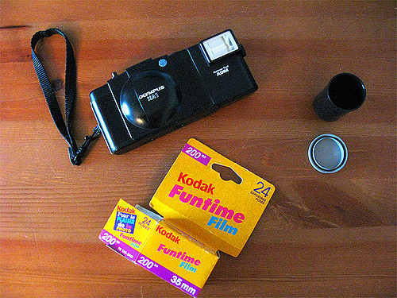
KODAK
Market Segmentation: A Fighting Brand for Kodak

Slide 46
KODAK
Proposed Product Line Strategy
What value do we create and for whom?
Very Special Occasions
Professional Brand:
Ektar ($4.27 retail)
Everyday Use
Non-Professional Brand:
Gold Plus ($3.49 retail)
Casual Picture Taking

Slide 47
KODAK
Goldilocks Economics
Will this fix our problem?
Implications for the business?

Slide 48
KODAK
The Situation in Rochester a Decade Later
Let’s establish a baseline for comparison
Assume the market is flat and we lose another 6 share points to Fuji over the next 4 years (1.5 points per year) down to 64%

Slide 49
KODAK
Offsetting Losses with Lower Margin Product
To restore all the lost contribution Kodak would need to get $78.39 MM / $1.56 per roll = 50.25 MM rolls
If Funtime can get X% of lost 40.2 MM rolls at $1.56 margin per roll, how much of the $78.39 MM lost contribution can be restored?

Slide 50
KODAK
Offsetting Losses with Lower Margin Product
If Funtime can get X% of lost 40MM rolls at $1.56 margin per roll, how much of the $78MM lost contribution can be restored?

Slide 51
KODAK
Let’s Start with Extreme Optimism
Funtime gets it all back from Fuji and then some
Funtime does not touch Gold Plus
Note: Baseline contribution with no Funtime is $836.16 MM on sales of 428.8MM rolls. Funtime margin is $1.56. Gold Plus margin is $1.95.

Slide 52
KODAK
Offsetting Losses with Lower Margin Product
Funtime gets it all back from Fuji
Funtime does not touch Gold Plus
Note: Baseline contribution with no Funtime is $836.16 MM on sales of 428.8MM rolls. Funtime margin is $1.56. Gold Plus margin is $1.95.

Slide 53
KODAK
Killed by Cannibalization
Funtime does not touch Fuji
Funtime devours Gold Plus
Note: Baseline contribution with no Funtime is $836.16 MM on sales of 428.8MM rolls. Funtime margin is $1.56. Gold Plus margin is $1.95.

Slide 54
KODAK
A Blend of Optimism and Realism?
Funtime gets it all back from Fuji
Funtime causes up to a 37.5% reduction in Gold Plus
Any Gold Plus reduction beyond 37.5% drives contribution lower than simply not launching Funtime
Note: Baseline contribution with no Funtime is $836.16 MM on sales of 428.8MM rolls. Funtime margin is $1.56. Gold Plus margin is $1.95.

Slide 55
KODAK
A Balanced View?
Funtime gets half back from Fuji
Funtime causes up to an 18.75% reduction in Gold Plus
Any Gold Plus reduction beyond 18.75% drives contribution lower than simply not launching Funtime
Note: Baseline contribution with no Funtime is $836.16 MM on sales of 428.8MM rolls. Funtime margin is $1.56. Gold Plus margin is $1.95.

Slide 56
KODAK
What About Analytics?
With historical data we can model own and competitive price response functions
What about Funtime?
No historical data!

Slide 57
KODAK
What Would You Do?
Wisdom of launching Funtime depends on your beliefs about the recapture rate and the rate at which Funtime eats into Gold Plus
Tough decision fraught with uncertainty and risk
So what did Kodak do?

Slide 58
MARKETING ANALYTICS
Key Concepts from Today
Mathematical Identities
Margins
Profits
Breakeven Volumes
Empirical Relationships
Sales Response Functions
What Variables?
Competitive Effects
Customer Value
Value in Use
Functional Value
Experiential Value

Slide 59

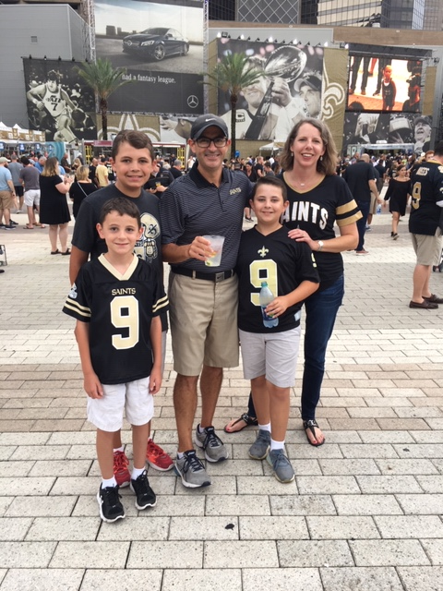
SONNIER
Who is he?

Slide 60







SONNIER
The Accidental Marketer
Degree, Jobs
Time

Slide 61
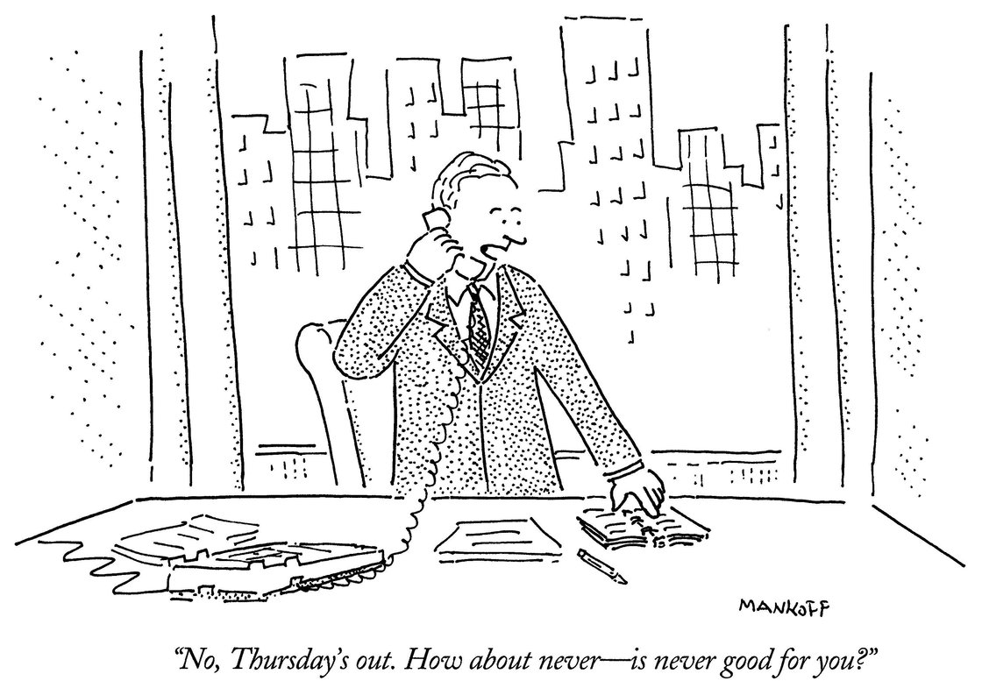
SONNIER
Where can I find him?
Office: CBA 7.256
Email: garrett.sonnier@mccombs.utexas.edu
Phone: 512.471.9197 (Do not leave message)
Office Hours: Monday 2:30 PM – 3:30 PM or by appt.

Slide 62
MARKETING ANALYTICS I
Course Materials
Course Packet (required for purchase)
XLSTAT Premium (provided by PO)
Textbooks (not required!)
Introductory Econometrics: A Modern Approach (6th Edition) by Jeffery Woolridge
Database Marketing: Analyzing and Managing Customers by Robert Blattberg, Byung-Do Kim, and Scott Neslin
Marketing Management (15th Edition) by Phillip Kotler and Kevin Lane Keller
Lecture Notes (posted to Canvas)
Course Website (Canvas)
More details on materials can be found in the syllabus.

Slide 63
MARKETING ANALYTICS I
Group Project: Teams and Timeline
4 students per team
Self select by Wed Aug 31th at 5:00 PM
Record team membership in Google spreadsheet (link to sheet in Assignment page on Canvas )
Remaining students will be randomly assigned

Slide 64
MARKETING ANALYTICS I
Next Time and Beyond…
Focus on the Customer

